Slide 1

Furniture Price Prediction
Supervised by : Dr/ Engy Elshafei
Eng / Gomaa Elmokhtar

Slide 2

O u r Te a m : Alaa Emad D i na Al s hazly Zahraa Ahmed hagar Mohamed Yasm I ne Sam i r Yasm I ne sam i

Slide 3

Workﬂow
01 Business Understanding
02 Data Understanding
03 Data Preparation
04 Modelling & Evaluation 05 Conclusion

Slide 4


01
Business Understanding
Furniture Price Prediction

Slide 5

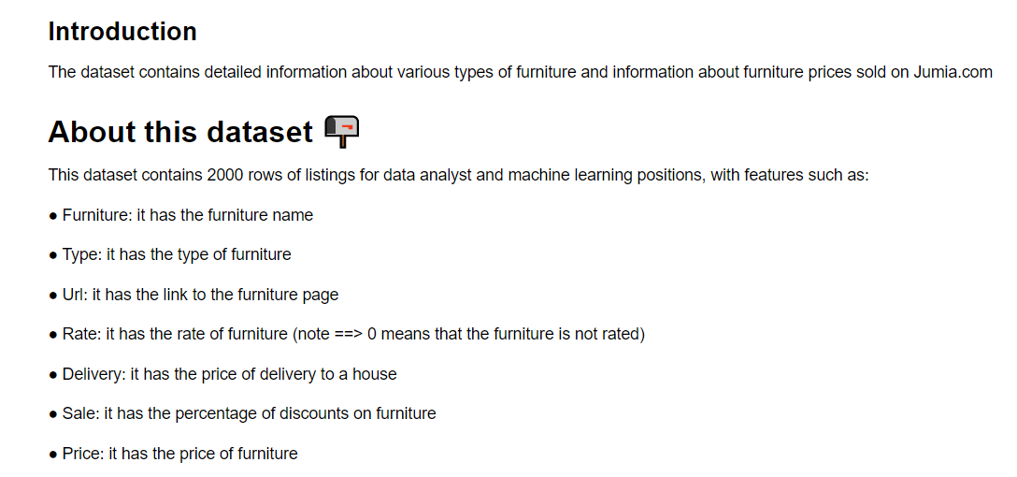
Overview
Source: Kaggle. “Prices of Furniture collected from Jumia”
Furniture Price Prediction | Kaggle

Slide 6
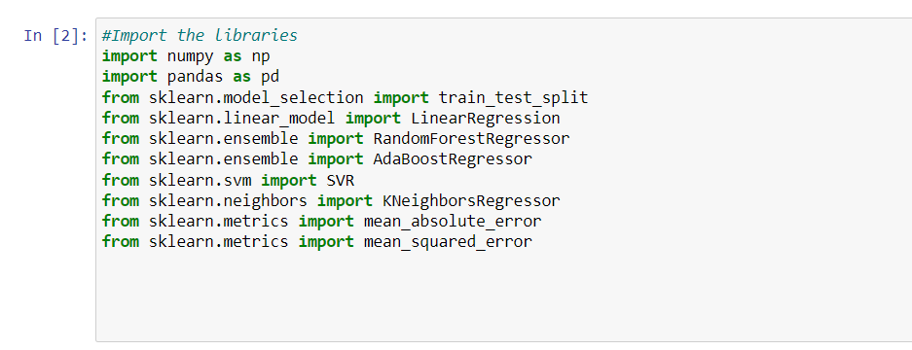
Import The Libraries

Slide 7
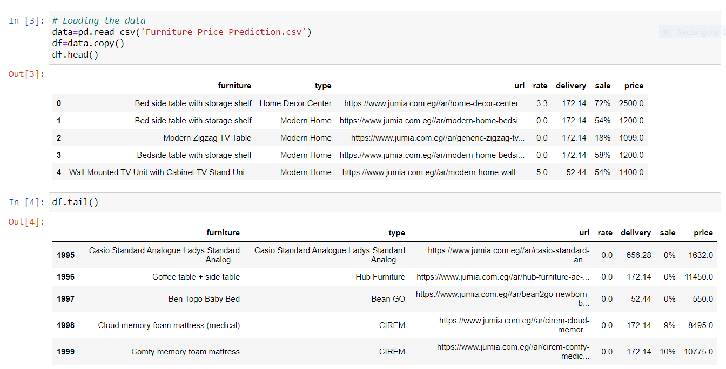
Loading The Data

Slide 8

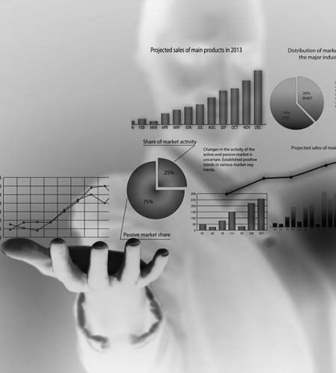
02
Data Understanding

Slide 9

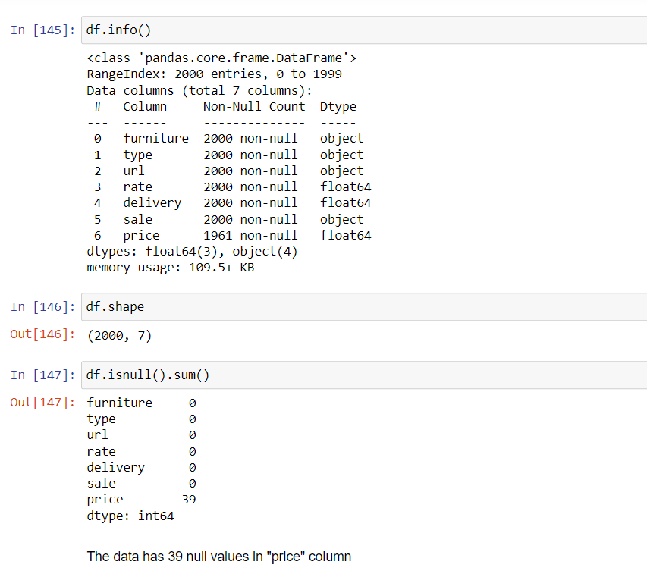
Data Overview

Slide 10

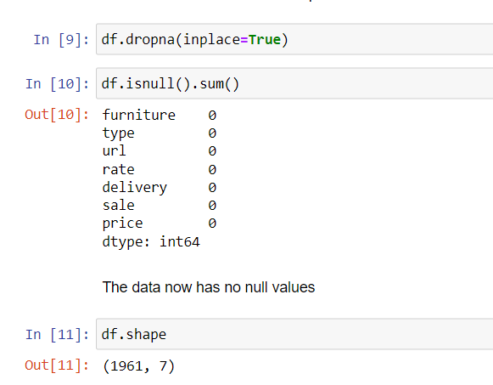
Remove Null Values

Slide 11
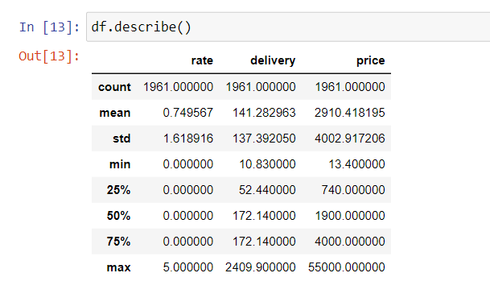
Descriptive Statistics

Slide 12


03
Data Preparation

Slide 13
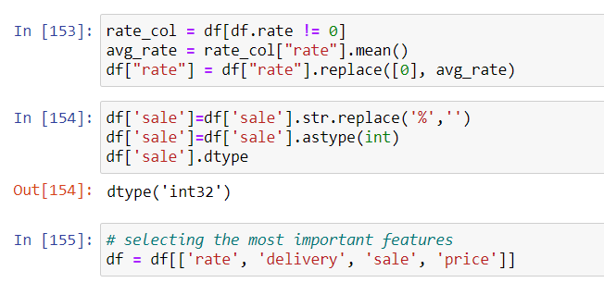
Data Preprocessing
Basically there are lot of unique variables for names and types of furniture. As I suggested, they are not fit for Label Encoder.
Hence, I decided to leave these features behind.
The only features I find fit enough for training models are:
rate delivery sale However, sale and rate features need additional pre-processing. We need to remove "%" sign from sale featuer and replce the retes of zeroes with the average rate

Slide 14


04
Modelling & Evaluation

Slide 15
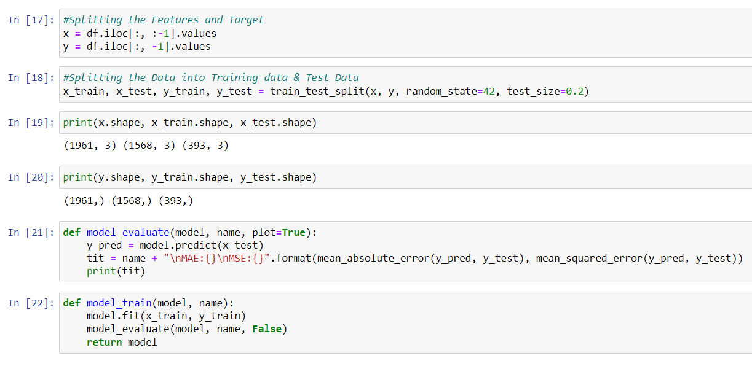
Modelling

Slide 16
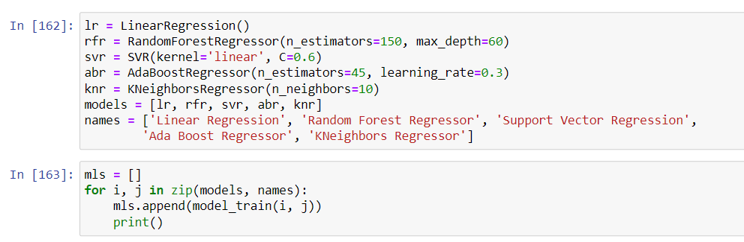
Evaluation

Slide 17
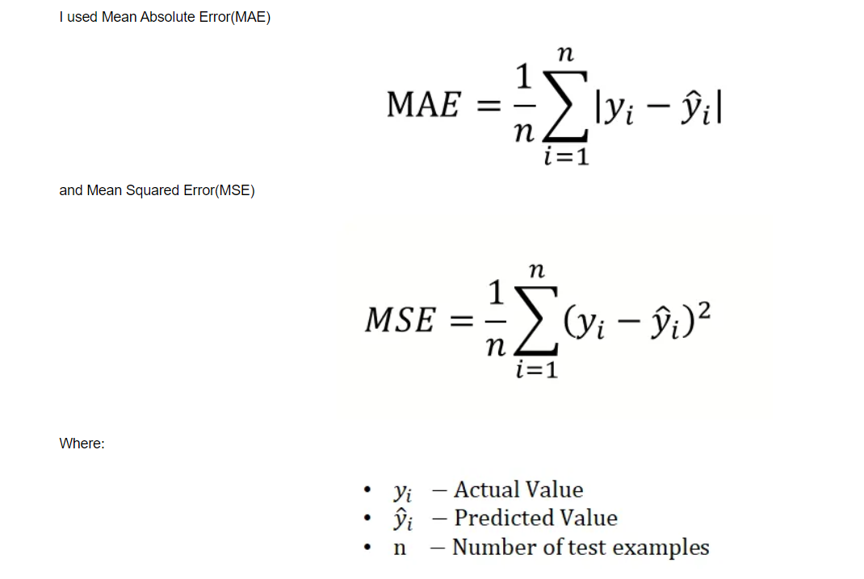
Evaluate Trained Models

Slide 18
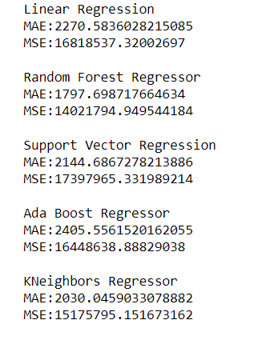
Models Performance Overview

Slide 19
05
Conclusion

Slide 20
Conclusion
The best and most consistent models used are:
Random Forest Regressor ( max_depth = 60 , n_estimators = 150 )
and KNeighborsRegressor with K=10

Slide 21
Thank You!
Furniture Price Prediction.ipynb : Click Here!

